Slide 1
Unit -2
ReactJs
Advanced Web Technology
Dept. of Computer Engineering

Slide 2
Content
Introduction,
Templating using JSX,
Components,
Working with state and props,
Rendering lists,
Event handling in React,
Understanding Component Lifecycle,
Forms,
Routing with React Router,
Redux

Slide 3
Introduction ReactJs
ReactJS is a declarative, efficient, and flexible JavaScript library for building reusable UI components. It is an open-source, component-based front end library responsible only for the view layer of the application.
It was created by Jordan Walke, who was a software engineer at Facebook. It was initially developed and maintained by Facebook and was later used in its products like WhatsApp & Instagram.
Facebook developed ReactJS in 2011 in its newsfeed section, but it was released to the public in the month of May 2013.

Slide 4
Templating using JSX
In the context of JSX (JavaScript XML), templating refers to the process of dynamically generating or composing the structure and content of JSX elements based on data or variables. JSX is a syntax extension for JavaScript that allows you to write HTML-like code within your JavaScript code.
In JSX, you can embed JavaScript expressions and statements by enclosing them in curly braces {}. This enables you to include dynamic content, perform computations, and make decisions based on the current state or props of your component.

Slide 5
Templating using JSX example:-
import React from 'react';
const User = ({ name, age }) => {
return (
<div>
<h2>{name}</h2>
<p>{age} years old</p>
</div>
);
};
const App = () => {
const user = { name: 'John Doe', age: 25 };
return (
<div>
<h1>User Details</h1>
<User name={user.name} age={user.age} />
</div>
);
};
export default App;

Slide 6
Components
Components are the building blocks of user interfaces in ReactJS. They are reusable and independent units of code that encapsulate specific functionality and UI elements. React components allow you to split your UI into smaller, manageable pieces, making it easier to develop, maintain, and test your application.

Slide 7
There are two types of components in ReactJS:
Functional components.
Class components.

Slide 8
Functional components
Functional Components: Functional components are JavaScript functions that receive props (properties) as arguments and return JSX elements. They are also known as stateless components because they don't have their own internal state. Functional components are simpler and easier to understand, making them a good choice for most UI elements that don't need to manage state or lifecycle methods.

Slide 9
Functional components
import React from 'react';
const Greeting = (props) => {
return <h1>Hello, {props.name}!</h1>;
};
export default Greeting;

Slide 10
Class components
Class Components: Class components are JavaScript classes that extend the React.Component base class. They have their own state and can define lifecycle methods. Class components were the traditional way of creating components in React before the introduction of hooks.

Slide 11
Example class components
import React, { Component } from 'react';
class Counter extends Component {
constructor(props) {
super(props);
this.state = { count: 0 };
}
incrementCount() {
this.setState((prevState) => ({
count: prevState.count + 1
}));
}
render() {
return (
<div>
<p>Count: {this.state.count}</p>
<button onClick={() => this.incrementCount()}>Increment</button>
</div>
);
}
}
export default Counter;

Slide 12
Working with state and props
In ReactJS, state and props are two fundamental concepts used to manage and pass data within components.
State is an object that represents the internal data of a component. It allows you to store and manage mutable data that can change over time. State is used to keep track of information that affects the component's rendering and behavior.
To work with state in a class component, you need to define the state object within the component's constructor using this.state = initialState;. You can then access and update the state using this.setState(newState);, which triggers a re-render of the component.

Slide 13
State example :-
import React, { Component } from 'react';
class Counter extends Component {
constructor(props) {
super(props);
this.state = {
count: 0
};
}
incrementCount() {
this.setState((prevState) => ({
count: prevState.count + 1
}));
}
render() {
return (
<div>
<p>Count: {this.state.count}</p>
<button onClick={() => this.incrementCount()}>Increment</button>
</div>
);
}
}
export default Counter;

Slide 14
Props
Props (short for properties) are read-only values that are passed to a component from its parent component. They allow you to pass data and configuration from one component to another.
Props are received as function arguments in functional components or accessed via 'this.props' in class components. They are immutable and cannot be modified within the receiving component.

Slide 15
Example props;-
import React from 'react';
const Greeting = (props) => {
return <h1>Hello, {props.name}!</h1>;
};
export default Greeting;

Slide 16
Props example:-
Props can be passed from a parent component to a child component by specifying the prop values as attributes when rendering the child component.
import React from 'react';
import Greeting from './Greeting';
const App = () => {
return <Greeting name="John Doe" />;
};
export default App;

Slide 17
Rendering lists
Rendering lists in ReactJS involves mapping over an array of data and generating a list of components based on that data. React provides a convenient way to render lists using the map() method of arrays.

Slide 18
Example rendering list:-
import React from 'react';
const ItemList = () => {
const items = ['Item 1', 'Item 2', 'Item 3'];
return (
<ul>
{items.map((item, index) => (
<li key={index}>{item}</li>
))}
</ul>
);
};
export default ItemList;

Slide 19
Rendering lists
Note:- that the key prop should have a unique value for each item in the list. In this example, we're using the index as a key, but if your list items have unique IDs, it's recommended to use those instead for better performance.

Slide 20
Event handling in React
In essence, event handling in React enables a user to interact with a webpage and take specified action whenever an event, like a click or a hover, takes place. Events in React are fired when a user interacts with an application, such as mouseovers, key presses, change events, and so on.

Slide 21
Example event handling :-
import React from 'react';
const ExampleComponent = () => {
const handleClick = () => {
console.log('Button clicked!');
};
const handleChange = (event) => {
console.log('Input value:', event.target.value);
};
return (
<div>
<button onClick={handleClick}>Click Me</button>
<input type="text" onChange={handleChange} />
</div>
);
};
export default ExampleComponent;

Slide 22
Some of the events in ReactJs
The following are some specific events in React that you could encounter when interacting with websites built with React:
Clicking an element
Submitting a form
Scrolling page
Hovering an element
Loading a webpage
Input field change
User stroking a key
Image loading

Slide 23
Difference Between Html And React Event Handling
With a few syntax modifications, React event handling is identical to HTML. For example:
React uses camelCase for event names, while HTML uses lowercase.
Instead of passing a string as an event handler, we pass a function in React.

Slide 24
In HTML
<form onsubmit="console.log('clicked'); return false">
<button type="submit">Submit</button>
</form>

Slide 25
In ReactJs
function Form() {
function handleClick(e) {
e.preventDefault();
console.log('Clicked');
}
return (
<form onSubmit={handleClick}>
<button type="submit">Submit</button>
</form>
);
}

Slide 26
Understanding Component Life Cycle
In React, functional components are the primary way of creating reusable UI components. Unlike class components, functional components don't have a built-in lifecycle. However, with the introduction of React Hooks, you can achieve similar functionality and manage component lifecycle events in functional components.
Here's an overview of the lifecycle events in functional components using React Hooks:

Slide 27
Mounting Phase:
useState: Allows you to add state to your functional components.
useEffect (with an empty dependency array [ ] ): Equivalent to componentDidMount. It runs only once, immediately after the component is mounted. You can perform tasks such as data fetching, subscriptions, or manually managing event listeners here.

Slide 28
Updating Phase:
useEffect (with a dependency array): This hook allows you to perform side effects whenever one or more dependencies change. It's similar to componentDidUpdate. You can update the component state or interact with external resources based on the changes in the dependencies.
useMemo and useCallback: These hooks can be used to memoize values and functions to optimize performance by preventing unnecessary recalculations.

Slide 29
Unmounting Phase:
useEffect (with a cleanup function): This hook allows you to clean up any resources or subscriptions created during the component's lifecycle. It's similar to componentWillUnmount. The cleanup function returned from useEffect is called when the component is unmounted.
Additionally, there are hooks available for handling other scenarios, such as handling context, handling form inputs, and more.

Slide 30
React LifeCycle Example:-
import React, { useState, useEffect } from 'react';
function MyComponent() {
const [count, setCount] = useState(0);
useEffect(() => {
// componentDidMount equivalent
console.log('Component mounted');
// componentWillUnmount equivalent
return () => {
console.log('Component unmounted');
};
}, []);
useEffect(() => {
// componentDidUpdate equivalent
console.log('Component updated');
}, [count]);
const handleClick = () => {
setCount(count + 1);
};
return (
<div>
<p>Count: {count}</p>
<button onClick={handleClick}>Increment</button>
</div>
);
}
export default MyComponent;

Slide 31
Forms in ReactJs
import React, { useState } from 'react';
function MyForm() {
const [name, setName] = useState('');
const [email, setEmail] = useState('');
const handleSubmit = (event) => {
event.preventDefault();
// Handle form submission logic here
console.log('Name:', name);
console.log('Email:', email);
};
return (
<form onSubmit={handleSubmit}>
<label>
Name:
<input
type="text"
value={name}
onChange={(e) => setName(e.target.value)}
/>
</label>
<br />
<label>
Email:
<input
type="email"
value={email}
onChange={(e) => setEmail(e.target.value)}
/>
</label>
<br />
<button type="submit">Submit</button>
</form>
);
}
export default MyForm;

Slide 32
Forms
Forms in ReactJS allow users to input and submit data. React provides a convenient way to manage form state and handle form submissions using controlled components.

Slide 33
Example for form :-
import React, { useState } from 'react';
function MyForm() {
const [name, setName] = useState('');
const [email, setEmail] = useState('');
const [acceptedTerms, setAcceptedTerms] = useState(false);
const [selectedOption, setSelectedOption] = useState('');
const handleSubmit = (event) => {
event.preventDefault();
// Handle form submission logic here
console.log('Name:', name);
console.log('Email:', email);
console.log('Accepted Terms:', acceptedTerms);
console.log('Selected Option:', selectedOption);
};
return (
<form onSubmit={handleSubmit}>
<label>
Name:
<input
type="text"
value={name}
onChange={(e) => setName(e.target.value)}
/>
</label>
<br />
<label>
Email:
<input
type="email"
value={email}
onChange={(e) => setEmail(e.target.value)}
/>
</label>

Slide 34
Example for form contd:-
<br />
<label>
<input
type="checkbox"
checked={acceptedTerms}
onChange={(e) => setAcceptedTerms(e.target.checked)}
/>
I accept the terms and conditions
</label>
<br />
<label>
Select an option:
<select value={selectedOption} onChange={(e) => setSelectedOption(e.target.value)}>
<option value="">Select an option</option>
<option value="option1">Option 1</option>
<option value="option2">Option 2</option>
<option value="option3">Option 3</option>
</select>
</label>
<br />
<button type="submit">Submit</button>
</form>
);
}

Slide 35
Routing with React Router
Routing is a process in which a user is directed to different pages based on their action or request. ReactJS Router is mainly used for developing Single Page Web Applications. React Router is used to define multiple routes in the application.
React Router is a popular library in the React ecosystem that enables declarative routing in your React applications. It provides a set of components and utilities to handle navigation and rendering different components based on the current URL.
React Router helps you build single-page applications with multiple views and enables a smooth user experience by updating the UI without full page reloads.

Slide 36
React Router
Here are some key components provided by React Router:
BrowserRouter: This component uses HTML5 history API to synchronize the UI with the URL. It should be placed around the top-level of your application to enable routing functionality.
Switch: The Switch component is used to render the first matching Route or Redirect inside it. It allows exclusive rendering of components based on the current URL. When a Route inside the Switch matches, it renders the corresponding component, and the Switch stops evaluating the remaining Routes.

Slide 37
React Router
Route: The Route component defines a mapping between a URL path and the component to render when the path matches the current URL. It takes a path prop and a component prop (or render prop) to specify which component to render. Optionally, you can use the exact prop to match the exact path instead of a partial match.
Link: The Link component is used to navigate between different routes. It renders an <a> element with the specified destination URL. When clicked, it updates the URL and triggers the corresponding component rendering. This prevents full page reloads and provides a seamless user experience.

Slide 38
React Router
NavLink: The NavLink component is similar to Link but provides additional styling and highlighting options. It allows you to add custom CSS classes to the active link based on the current URL, making it easy to apply different styles to active links.
Redirect: The Redirect component is used to redirect the user to a different URL. It takes a to prop that specifies the destination URL. When rendered, it automatically updates the URL and redirects the user to the specified location.

Slide 39
import React from ‘react’
function Home( ) {
return (
<h4> Welcome to Home Page ! </h4>
)
}
export default Home

Slide 40
import React from ‘react’
function About( ) {
return (
<h4> Welcome to About ! </h4>
)
}
export default About

Slide 41
import React from ‘react’
function Contact( ) {
return (
<h4> Welcome to Contact ! </h4>
)
}
export default Contact

Slide 42
React Router example:-
import React from 'react';
import { BrowserRouter as Router, Routes,Route, Link } from 'react-router-dom';
// Components for each route
import Home from './components/Home';
import About from './components/About';
import Contact from './components/Contact';
function App() {
return (
<Router>
<div>
<nav>
<ul>
<li>
<Link to="/">Home</Link>
</li>
<li>
<Link to="/about">About</Link>
</li>
<li>
<Link to="/contact">Contact</Link>
</li>
</ul>
</nav>
<Routes>
<Route path="/" exact element={<Home />} />
<Route path="/about" element={<About />} />
<Route path="/contact" element={<Contact />} />
</Routes>
</div>
</Router>
);
}
export default App;

Slide 43
Redux
Redux is an open-source JavaScript library used to manage application state. React uses Redux for building the user interface. It was first introduced by Dan Abramov and Andrew Clark in 2015.
Redux is a state management library that helps manage the state of an application in a predictable and centralized manner. It is commonly used with React but can be used with any JavaScript framework or library. Redux follows a unidirectional data flow pattern and maintains the state of the entire application in a single store.

Slide 44
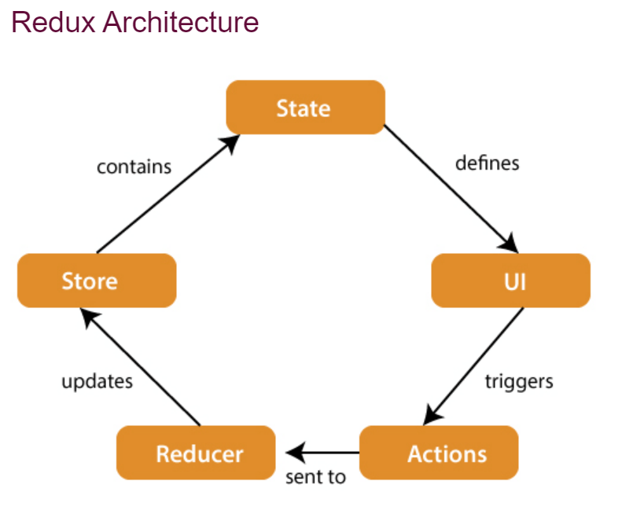
Redux

Slide 45
Redux
Action: Actions are plain JavaScript objects that describe a specific event or intention to change the state of the application. Actions are dispatched to the Redux store and carry a type property that describes the action's purpose. They can also contain additional data or payload required to update the state.
Reducers: Reducers are pure functions responsible for handling actions and updating the state of the application. They take the current state and an action as input and produce a new state based on the action's type and payload. Each reducer typically handles a specific portion of the overall application state.
Dispatch: The dispatch function is used to send actions to the Redux store. It is provided by the store and is used to trigger state updates. When an action is dispatched, it is passed to the reducers, which update the state accordingly.

Slide 46
Redux
Store: The store holds the application state and serves as the single source of truth. It is created using the createStore function from Redux. The store is responsible for dispatching actions, maintaining the application state, and notifying subscribers of state changes.
Subscribers: Subscribers are functions or components that subscribe to the Redux store to receive updates whenever the state changes. They can be React components or other parts of the application interested in observing changes in the state. When the state changes, the subscribers are notified, allowing them to update the UI or take other actions.
View: The view represents the user interface (UI) of the application. It can be a React component or any other UI rendering mechanism. The view interacts with the store by dispatching actions and receives updated state through subscriptions. It renders the updated state to the user interface, reflecting the changes in the application's state

Slide 47
Thank You

